Slide 1
Introduction to Digital Imaging and Communication in Medicine (DICOM) II 蕭嘉宏
Part II:
-Structure of DICOM images
-DICOM Basic communication

Slide 2
Today Topics
Structure of DICOM images
Basic concept
Review of Grayscale Standard Display Function
Review of Grayscale Presentation State
Practical examples: use of DCMTK
Basic communication
Basic concept
DICOM communication service classes

Slide 3
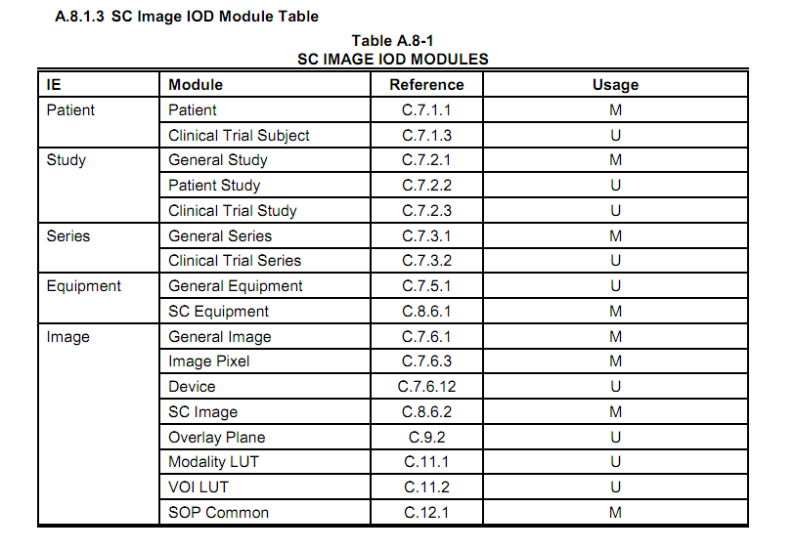
Image IOD- Secondary Capture
Image Data:
Resolution
Color model
Pixel data
Encoding
Grayscale transformation

Slide 4
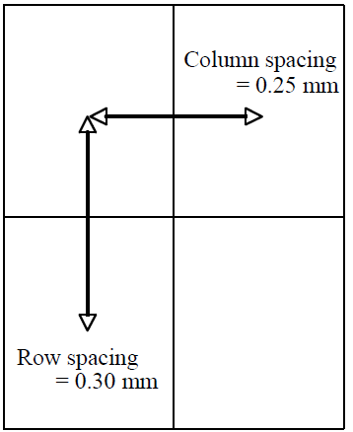
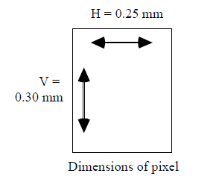
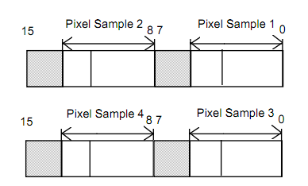

Image Pixel Module
Spatial Resolution: “Rows”, “Columns”
Pixel Spacing Value: physical distance between two pixels
Photometric Interpretation: color model
Monochrome 1+2, RGB, YCbCr, Palette Color, CMYJ,
Pixel aspect ratio = Vertical Size \ Horizontal Size
= 0.30 mm \0.25 mm. ("6\5", or "60\50” ..etc)
Planarity for color images : “Planar Configuration”
“color-by-plane” or “color-by-pixel”
Sign extension of pixel data: “Pixel Representation”
Encoding: “Samples per Pixel”, “Bits Allocated” “Bits Stored”
Bits allocated = 16
Bits stored + 12
High bit = 11
Bits allocated = 8
Bits stored = 6
High bit = 5

Slide 5
Advanced image modules:
Modality LUT(Look-up table)
Transformation of manufacturer dependent pixel values into pixel values which are manufacturer independent
May be contained within an image, or sorted a presentation state separately from the image.
VOI LUT (Value of interest)
Transformation of the modality pixel values into pixel values that are meaningful for print, display, etc.
May be contained within an image, or sorted a presentation state separately from the image.
Overlay plane/multi-frame overlay
Monochrome bitmaps overlay on the image.
Multi-frame module
Number of frames in the image (ex: nuclear medicine Image )

Slide 6
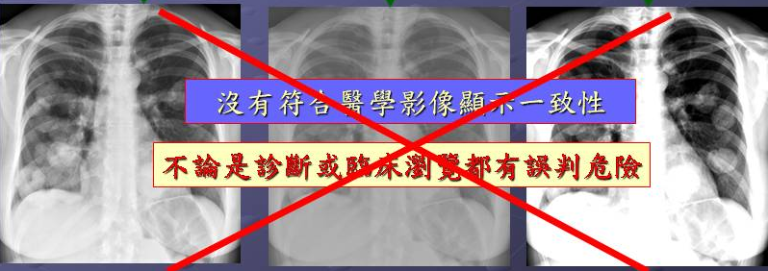
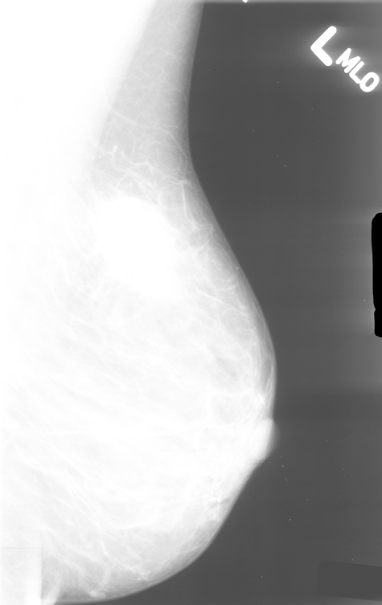
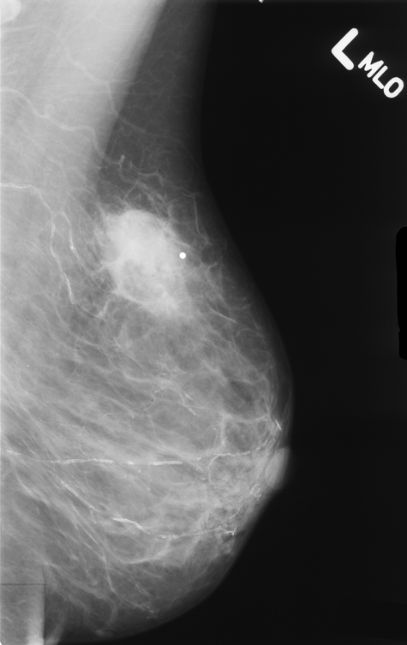
Problems of Inconsistency
If, without correction …
VOI chosen on monitor A display device
Rendered on monitor B with different display
Result: Mass expected to be seen is no longer seen
It is dangerous if image display is not consistent for diagnosis or display
“Monitor A”
mass visible
“Monitor A”
mass invisible

Slide 7
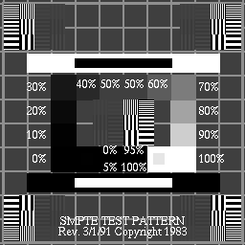
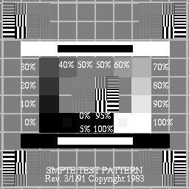
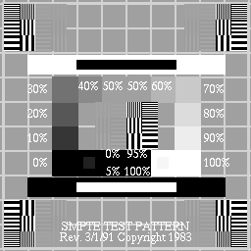
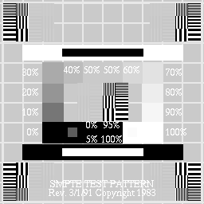

Problems of Inconsistency caused by different monitors
0.5
1.0
Not all display levels are perceivable on all devices
1.5
3.0
不同螢幕會有不同的顯示結果
Can’t use absolute luminance since display capabilities different

Slide 8
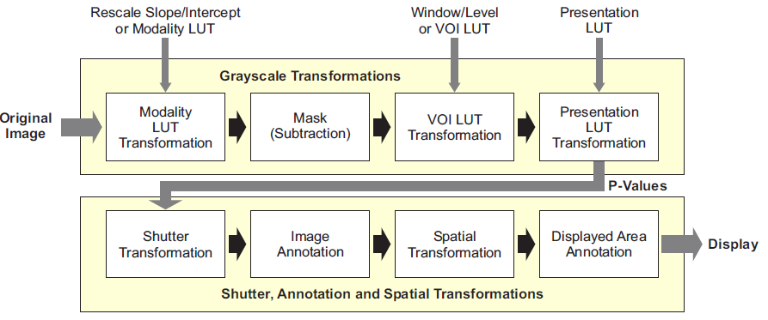
DICOM Grayscale Image Transformation Model
Notes:
10
Presentation LUT shape : IDENTITY, INVERSE

Slide 9
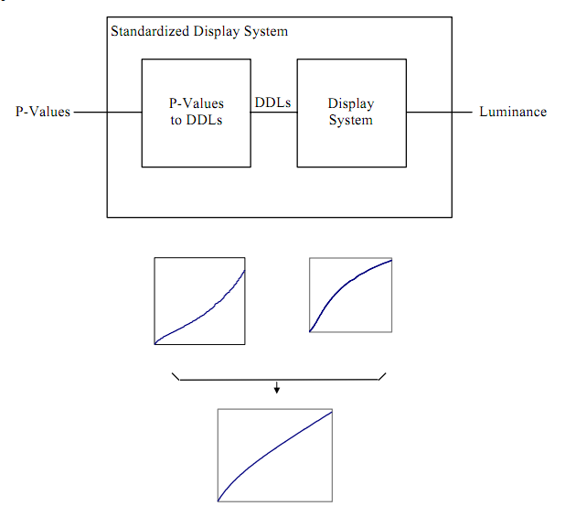
The conceptual model of a Standardized Display System maps P-Values to Luminance
The conceptual model of a Standardized
Display System maps P-Values to Luminance

Slide 10
Human Visual System
Model contrast sensitivity
assume a target similar to image features
confirm model with measurements
Barten’s model
Grayscale Standard Display Function:
Input: Just Noticeable Differences (JNDs)
Output: absolute luminance

Slide 11
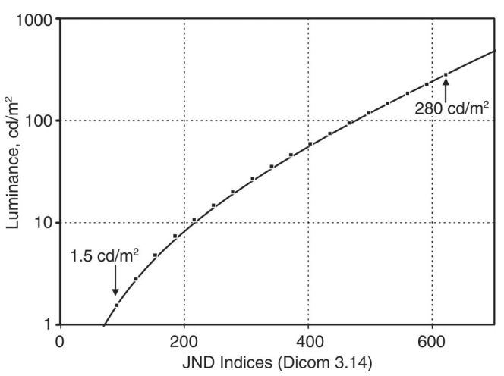
Grayscale Standard Display Function (GSDF)
less sensitive for human vision
More sensitive for human vision
logarithm-of-Luminance versus JND-Index

Slide 12
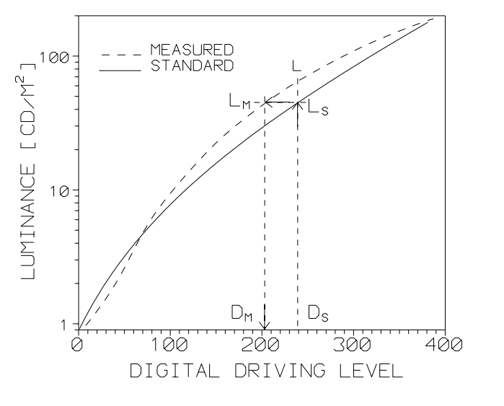
GSDF- real and standard
主要是在於讓不同的顯示器的類似度提高: (95% approximate to standard) Solution: exploit known characteristics of the contrast sensitivity of human visual system - contrast perception is different at different levels of luminance

Slide 13
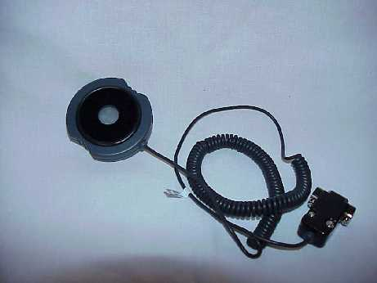
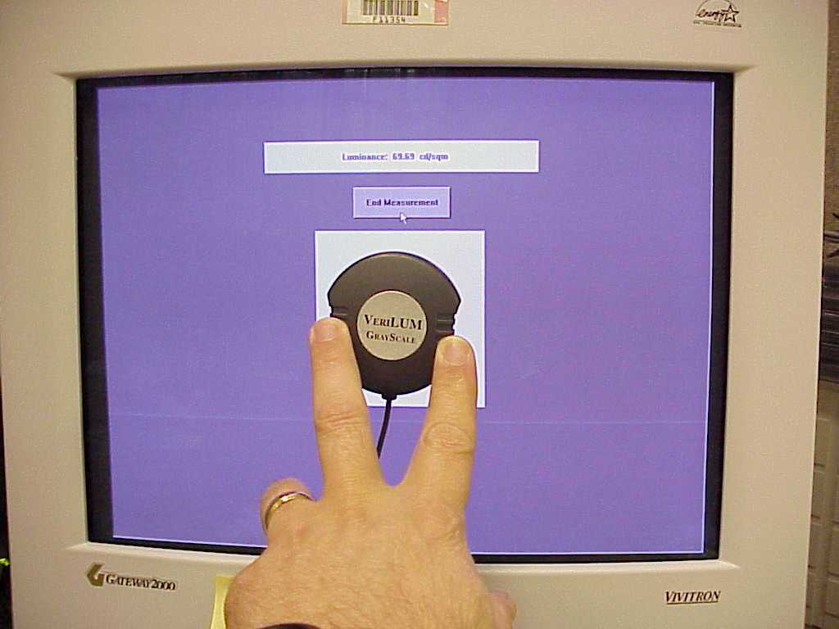
Display Calibration Tools (Photometer)
Slide Provided by Jerry Gaskill, Image Smiths Inc.

Slide 14
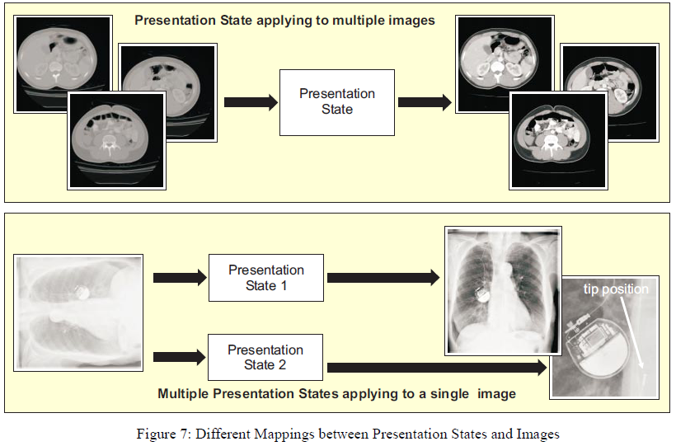
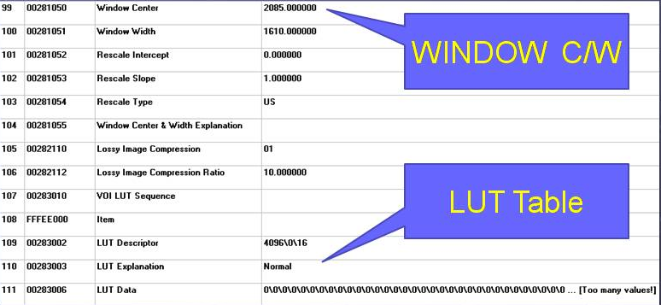
Different Mappings between Presentation States and Images

Slide 15
Practice Example
Purpose
To understand how to process a DICOM file.
How to use the OFFIS DICOM Toolkit (DCMTK)
Methods:
Use “dcmdump” to show the content of a DICOM file.
Use “dcm2pnm” to show the pixel data of a DICOM dataset.
Use “img2dcm” to create a DICOM image object from standard image file.
Use “dcm2xml” to convert a DICOM file to a XML file

Slide 16
DICOM Networks
-Basic concept
-Verification Service Class
-Storage Service Class
-DICOM Query/Retrieve

Slide 17
ACSE and DIMSE Services
ACSE (Association Control Service Element)
Service for association setup, negotiation and termination
DIMSE (DICOM Message Service Element)
Service for transmission, receipt DICOM message over network connection (ACSE).
ACSE is part of DICOM Upper layer, DIMSE makes use of the P-DATA service that is the part of the Upper Layer

Slide 18
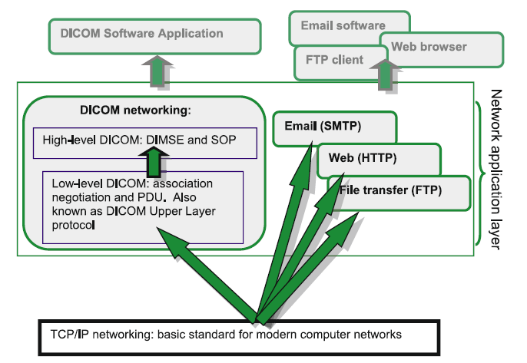
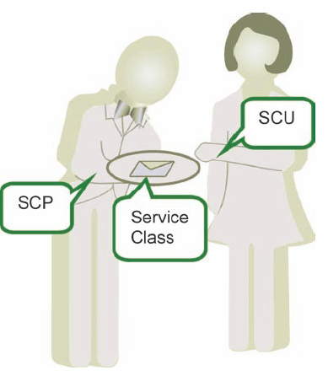
DICOM and popular networking protocols
Notes:
DICOM networking is the glue that holds any medical imaging system together.
While most of us used to think about DICOM as a simple medical image file
format, it really is a much broader standard that directs all facets of the clinical
workflow and goes far beyond the scope of managing formats for image files.
The entire digital medical universe is created and populated by DICOM objects
as they travel and interact through computer networks.
Interestingly enough, DICOM networking has been laid out in the standard
well before computer networks came into existence. Part PS3.9 of the
standard (Point-to-Point Communication Support for Message Exchange) was
using old-fashioned pin cables to interconnect DICOM devices. All this, including
PS3.9 itself, has vanished with the introduction of modern networking
hardware and protocols, which have become the foundation for contemporary
DICOM data exchange.
In plain words, current DICOM uses the exact same underlying TCP/
IP protocol, that you use for sending your email or watching online videos
(Fig. 31) (TCP stands for Transmission Control Protocol, and IP – for Inter-
net Protocol). TCP/IP nicely accommodates all hardware and software variations
and delivers the most fundamental network functionality needed: sending
information (as a sequence of bytes) from one port/IP address to another.
DICOM only adds to it its own networking language (the application layer),
which we are about to explore.
This language consists of high-level services, DICOM Message Service
Elements
(DIMSE), the subject of this chapter, which are built on low-level
DICOM association primitives (DICOM Upper Layer Protocol, DICOM UL
for short, a more technical discussion that will be covered in Chap. 9).
Although sometimes technical, all concepts used in DICOM networking
are quite intuitive; you really do not have to be an IT guru to understand them.
Moreover, knowing the principles of DICOM networking (at least on the highlevel)
will considerably improve your understanding of DICOM and PACS,
and your ability to deal with related projects. Consider this as a good reason for
reading this chapter.

Slide 19
A Successful DICOM Association
1)
Client
A-ASSOCIATE-RQ
Server
Client
A-ASSOCIATE-AC
Server
2)
Client
DIMSE
Server
3)
ACSE
P-DATA
Client
A-RELEASE-RQ
Server
4)
Client
A-RELEASE-RP
Server
5)

Slide 20
SCP and SCU
DICOM defines a set of network services which are object-oriented concept (instances for DICOM object, method for operations):
Data transmission, data access, printing, …
All network services are based on client/server services:
Service Class Provider (SCP): A system offering a networking service (server)
Service Class User (SCU): A system use a service (client)
SCU and SCP may communicate over the type of network:
TCP/IP network
OSI networks (ideal, but never used)
For TCP/IP, a simple OSI network (ACSE and P-DATA) is emulated on the top of the TCP/IP layer: DICOM Upper Layer Service for TCP/IP

Slide 21
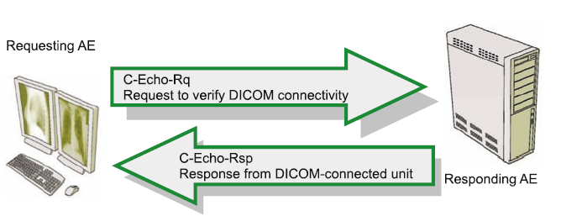
Verification Service Class
Purpose: Determine the DICOM association setup and DICOM communication (DICOM “ping”).
The service: SCU negotiates association with SCP
SCU sends C-ECHO-RQ to SCP
SCP sends C-ECHO-RSP back to SCU; done

Slide 22
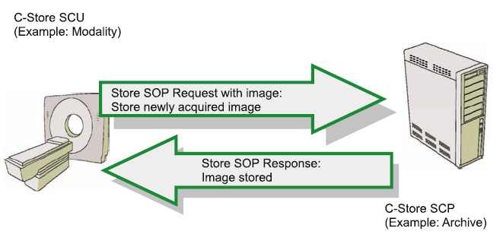
Storage Service Class
Purpose: is used for DICOM object transmission
Use of service:
SCU establishes association to SCP, negotiates SOP classes
sends C-STORE-RQ with DICOM object appended
SCP acknowledge receipt with C-STORE-RSP

Slide 23
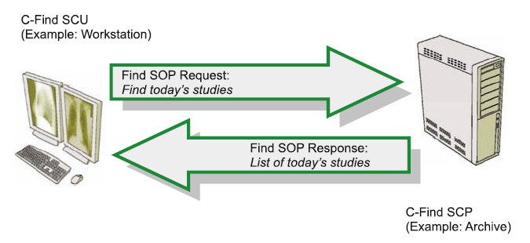
DICOM Query/Retrieve
Purpose: to find DICOM object.
All C-Find data searches into three data levels: Patient,
Study, and Patient-Study (Retired).
Use of service:
SCU sends C-FIND-RQ to SCP.
SCP sends C-FIND-RSP to SCP.
C-FIND-RQ: Find a list of all studies for patient with Patient ID 12345
C-FIND-RSP: A list of found study IODs

Slide 24
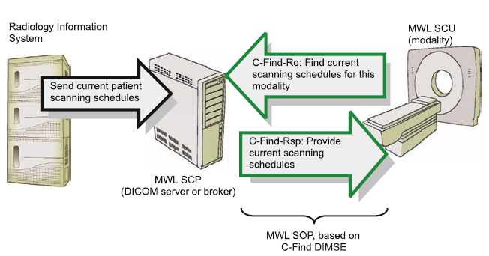
Other DICOM Service Classes
C-Cancel
C-Move
C-Get
C-Remove
Modality Worklist Management (MWL)
Modality Performed Procedure Step
Storage Commitment
DICOM MWL example: populating imaging modalities with basic patient data

Slide 25
Further DICOM
DICOM Structured Reporting
DICOM IODs for signals (e.g. ECG, Audio…)
Storage media and storage media exchange
DICOM compression
JPEG, JPEG-lossless, RLE, LPEG-LS, JPGE 2000
DICOM Security
TLS, digital signature, encryption, anonymization
IHE Integration Profile support

Slide 26
DICOM - Something news
New “Multi-frame” object for CT, MR, XA, XRF, PET
Surgery
Spectroscopy and Raw Data, Multi-dimensional images (e.g. pathology)
Embedded of PDF and HL7 CDA documents
Extended Presentation States, structured Display
JPEG 2000 Interactive Protocol (JPIP)
Web Access to DICOM object (WADO)
…

Slide 27
Further DICOM resources
David Clunie's Medical Image Format Site:
http://dclunie.com/
DICOM Committee Homepage
http://dicom.nema.org/
OFFIS DICOM Toolkit and DICOM page
http://dicom.offis.de/ and http://dicom/offis.de/dcmtk
Integrating the Healthcare Enterprise (IHE)
http://www.ihe.net/ and http://willi.ihe.net/

Slide 28
For further questions: cylien.dicom@gmail.com
Too much of implementations and tools
Too much implementations and tools are free and open source, that are well supported
Do not fear DICOM so “complexity”
We are DICOM compatible

